Slide 1
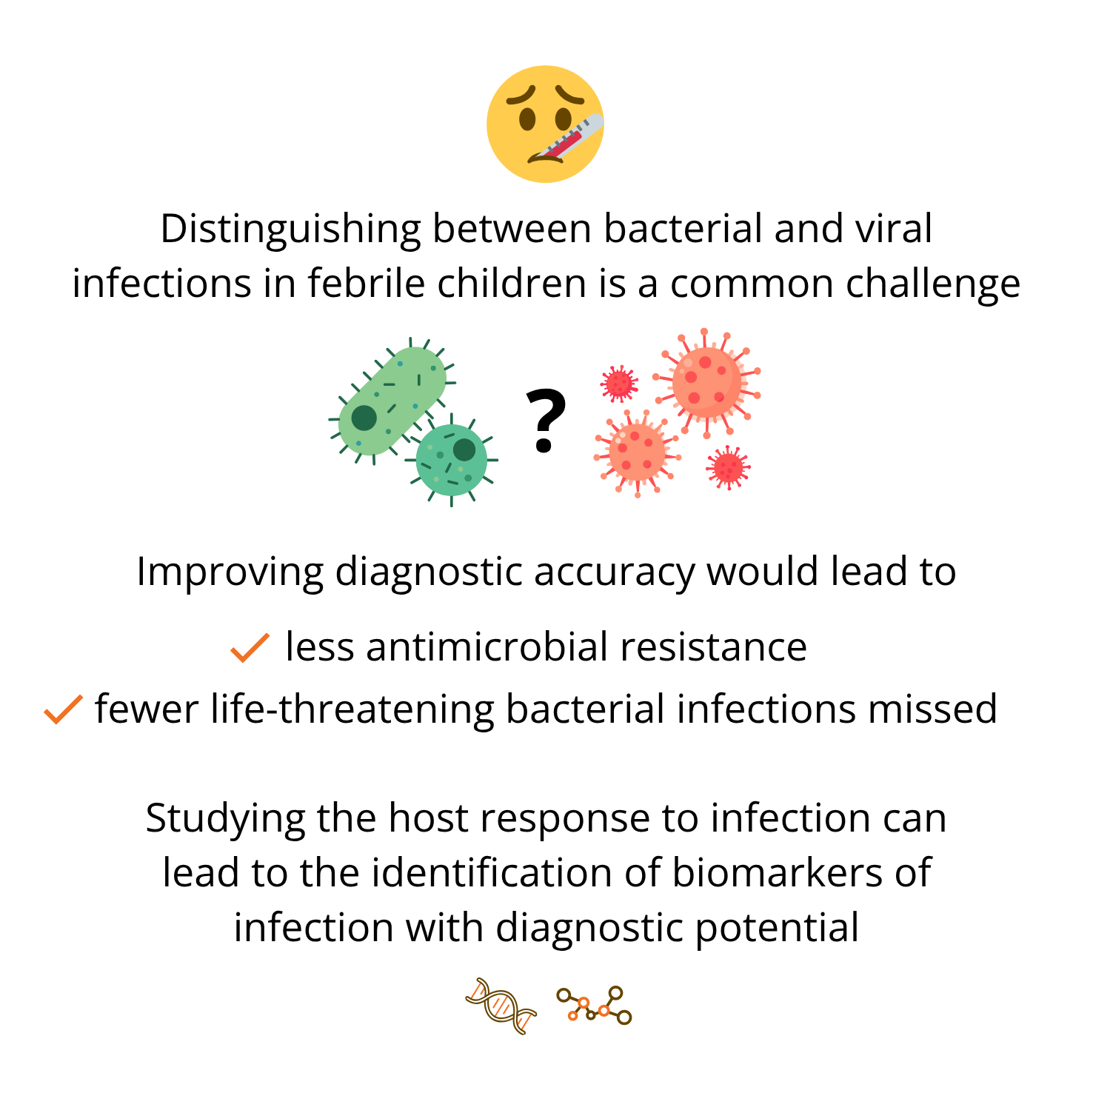


Project 1 - Identifying Protein Biomarkers for Diagnosing Paediatric Infectious Disease
Project Background
Aim
To identify host protein biomarkers for development into an accurate, rapid point-of-care test that can distinguish between bacterial and viral infections in febrile children
Read the paper here

Slide 2
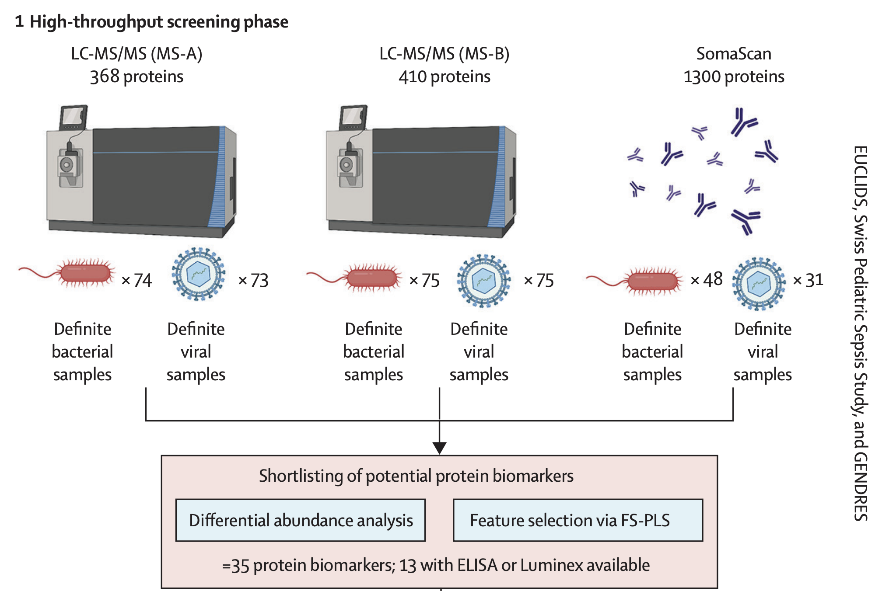
Project 1 - Identifying Protein Biomarkers for Diagnosing Paediatric Infectious Disease
Phase 1 - biomarker discovery
Using three high-dimensional proteomic datasets generated from two types of platforms, I performed extensive data pre-processing and quality control. Each dataset contained samples from patients with confirmed bacterial and viral infections with no overlapping patients between datasets.
The exact pre-processing pipeline differed according to the specifics of the proteomic platform (i.e., targeted vs. untargeted quantification).
The goal of this phase was to identify a shortlist of protein biomarker candidates to take forward into cross-platform validation.

Slide 3
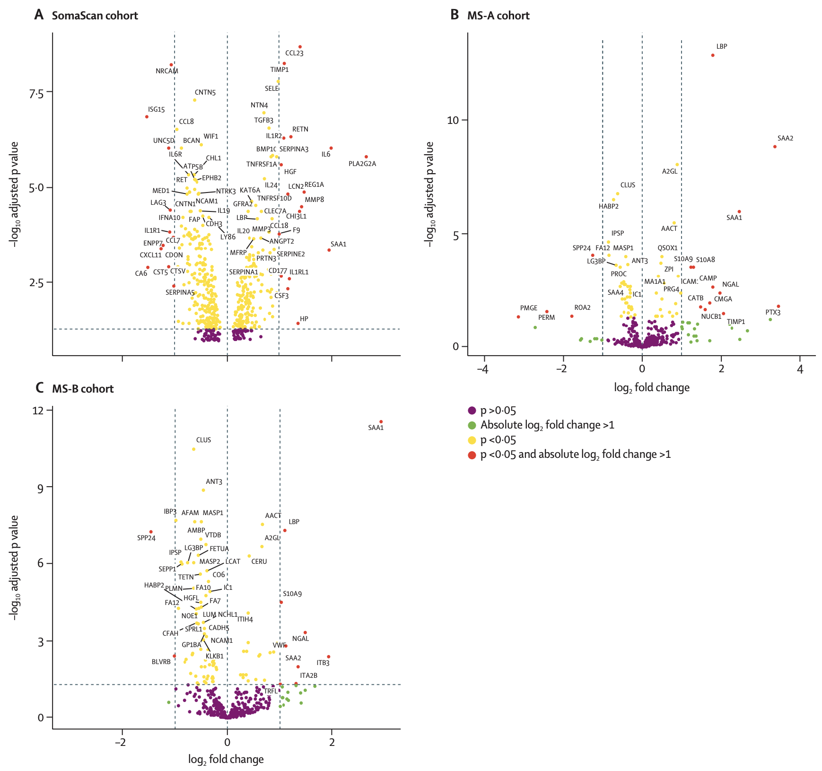
Project 1 - Identifying Protein Biomarkers for Diagnosing Paediatric Infectious Disease
Phase 1 - biomarker discovery
I applied differential abundance analysis to the three proteomic datasets, identifying a long list of proteins with different levels between bacterial vs. viral infections.
Then, to each dataset, I applied a machine learning algorithm that combines forward selection with partial least squares (FS-PLS) with repeated cross-validation, identifying hundreds of potential biomarker models.
I created a ranking method, considering both differential abundance analysis and FS-PLS results, taking forward the most promising candidates and those that were repeatedly selected across datasets and between iterations.
SomaScan: 431 significant proteins
MS-A: 54 significant proteins
MS-B: 97 significant proteins
16 proteins significant in all 3 datasets
35 biomarker candidates

Slide 4
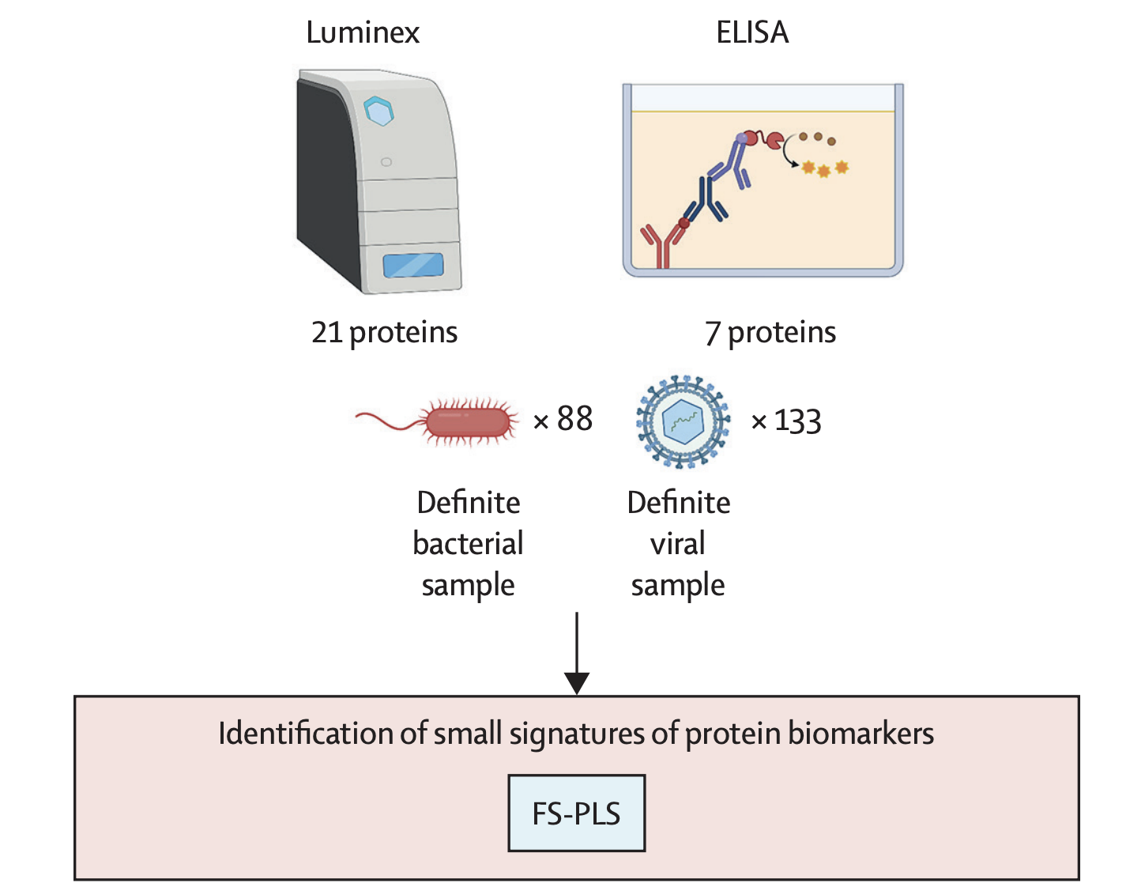
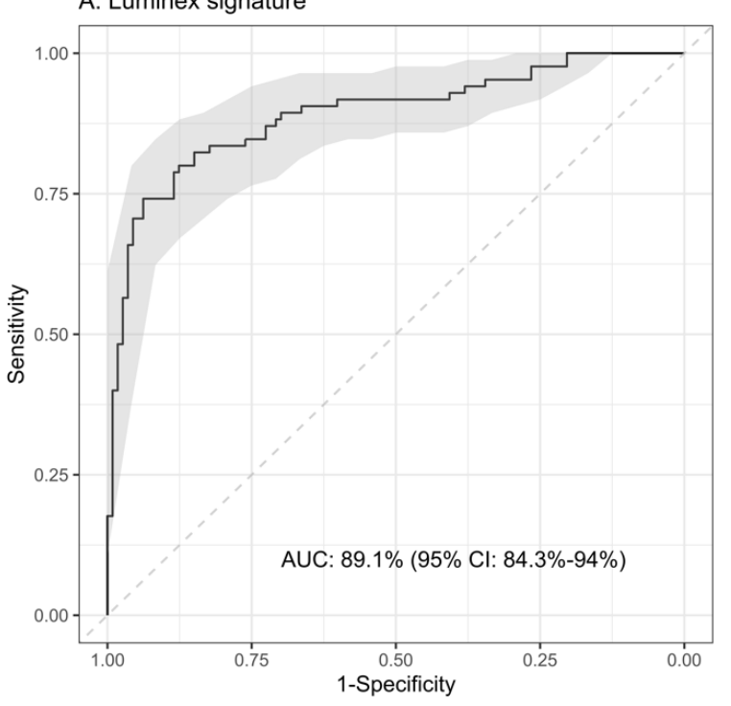
Project 1 - Identifying Protein Biomarkers for Diagnosing Paediatric Infectious Disease
Phase 2 - signature refinement and cross-platform validation
Of the 35 protein biomarker candidates, 28 were measured using ELISA and Luminex immunoassays – low-throughput quantification methods that are more similar to point-of-care methodologies.
I applied FS-PLS with repeated cross-validation to this pool of 28 protein biomarkers, identifying a signature composed of the following proteins and selected in 7/25 iterations: NCAM1, IL18, SELE, NGAL and IFN-γ
The signature performed well overall (AUC: 89.1%), with high sensitivity for bacterial infections (90.4%) but lower specificity (67%), mislabelling about one-third of viral cases as bacterial.
I identified Galectin-3BP as an additional marker to improve discrimination between bacterial and viral infections in cases where bacterial infections appeared more viral clinically.

Slide 5
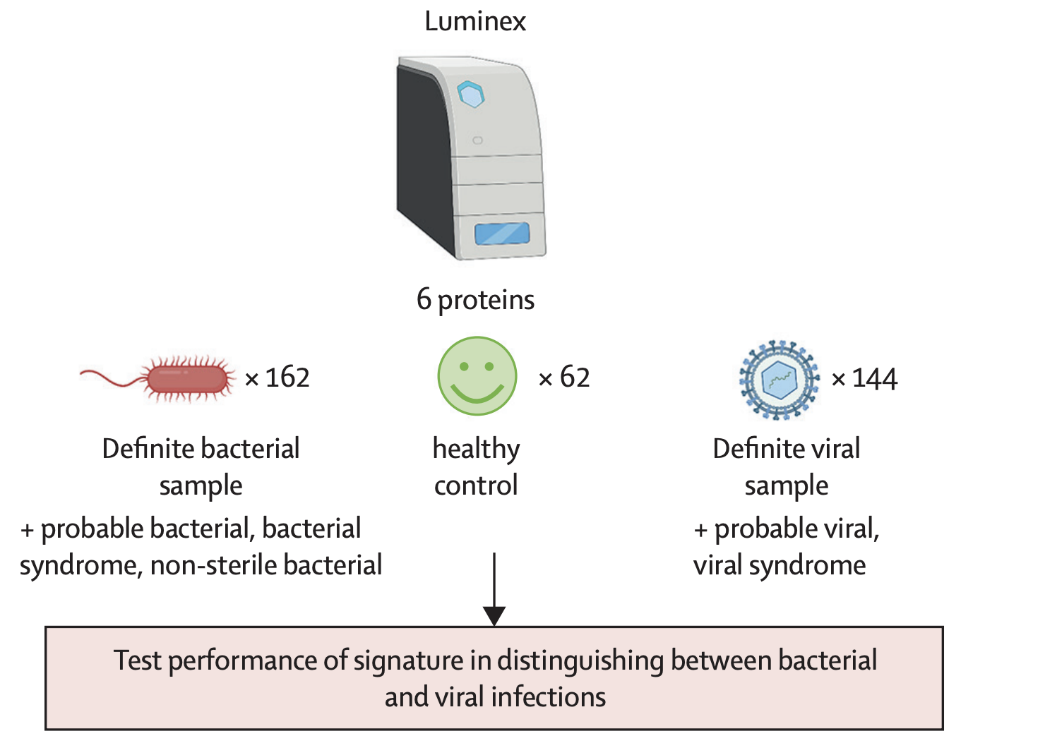
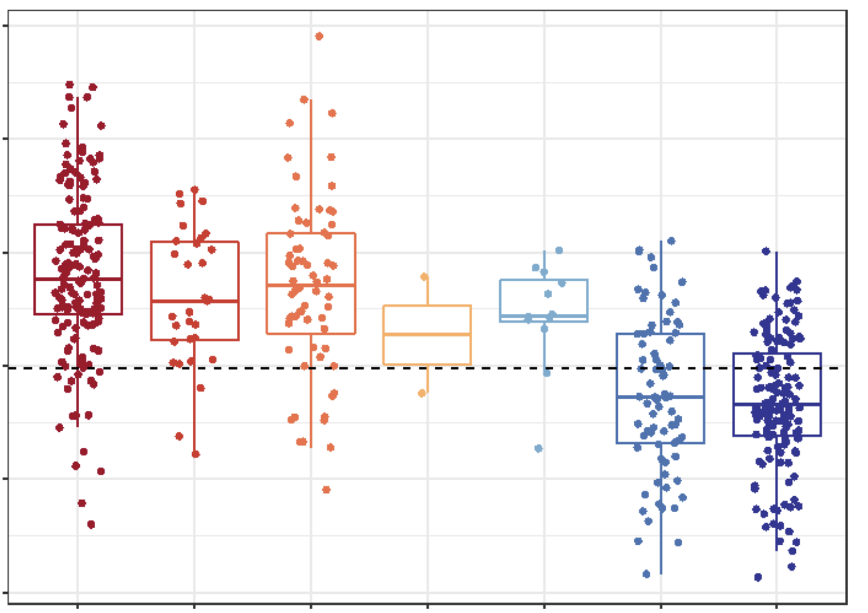
Project 1 - Identifying Protein Biomarkers for Diagnosing Paediatric Infectious Disease
Phase 3 - final signature validation
A further validation study was performed using Luminex, this time measuring the 6 optimal proteins identified in phase 2 (NCAM1, IL18, SELE, NGAL, IFN-γ, Galectin-3BP).
This signature performed well overall (AUC >89%) and could accurately identify both bacterial (sensitivity: 88.1%) and viral (specificity: 84.9%) infections.
Signature discovery used confirmed cases, but most real-world cases are unconfirmed. In suspected (but unconfirmed) cases, the signature still aligned with clinical assessment, identifying likely bacterial and viral infections correctly.
This suggests it could support more confident treatment decisions in children.
Bacterial classification score
True bacterial
Likely bacterial
Likely viral
True
viral

Slide 6
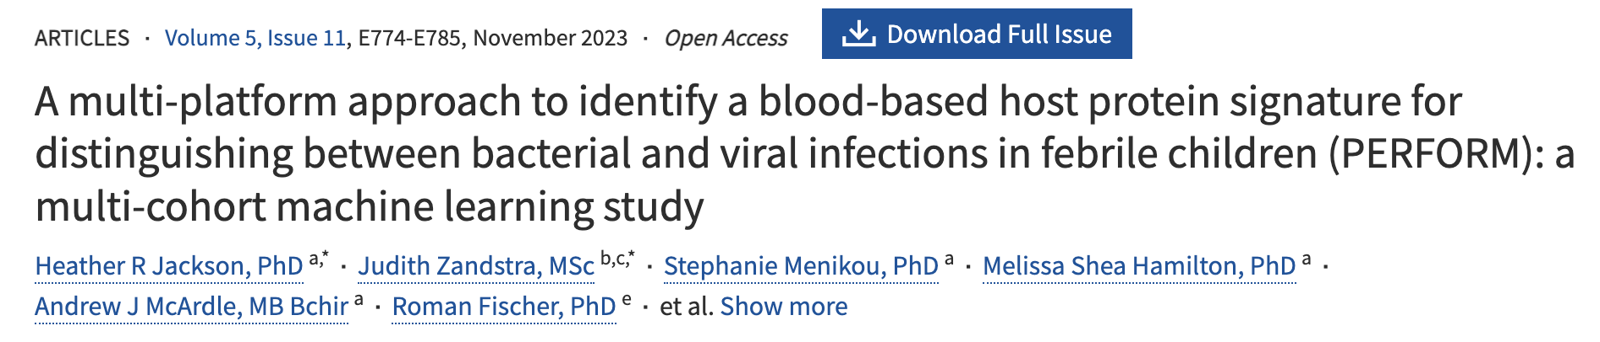
Project 1 - Identifying Protein Biomarkers for Diagnosing Paediatric Infectious Disease
Outcomes
Project Conclusions
Through interrogating 5 different datasets, I successfully identified a 6-protein signature that displayed excellent performance in distinguishing between bacterial and viral infections.
Furthermore, the signature showed potential to improve diagnosis in borderline or uncertain cases, which comprise the majority of childhood fevers.
If integrated into routine clinical practice, this signature could reduce the burden of antimicrobial resistance while ensuring children with serious bacterial infections receive timely treatment.
Published in a leading peer-reviewed journal (Lancet Digital Health) with an impact factor of 24.1
Read the paper here
Patent filed to protect the 6-protein signature (here):
A host protein signature for distinguishing between bacterial and viral infections in febrile children filed August 2024 (International Patent Cooperation Treaty number: PCT/GB2024/052214) by Jackson, HR, Kaforou, M, Levin, M, Kuijpers, T, de Jonge, M
Ongoing work to translate the signature into a rapid point-of-care diagnostic test (Imperial College).

